Slide 1
Case Study Project - Office Supplies
Last Updated: November 2022

Slide 2

BUSINESS GOALS
/01
Are there products that do not sell as well in some locations?
/02
Are there any other patterns over time in each region that you can find in the data?

Slide 3
Data Analysis Workflow
/01
/02
/03
Data preparation
Data Analysis
Conclusions
Exploratory data analysis
Checking data quality
Cleaning data
Transformation
Modelling
Visualization
Key findings
Answer the customer questions
Recommendations

Slide 4
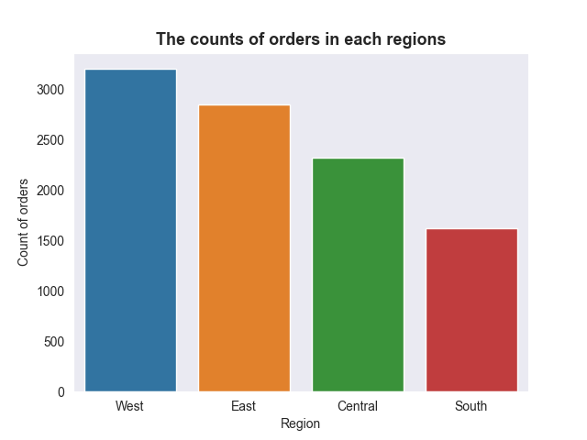
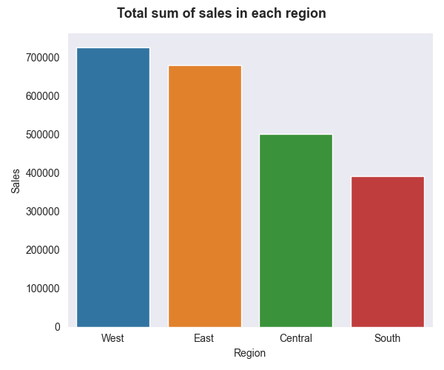
- The data collected from 2014 to 2017.
- Each row of the dataset contains information about one order.
- The dataset has the following columns: Order ID, Order Date, Region, Product ID, Category, Sales, Quantity etc.
- Warehouses in four regions: East, West, South, and Central
DATA OVERVIEW

Slide 5
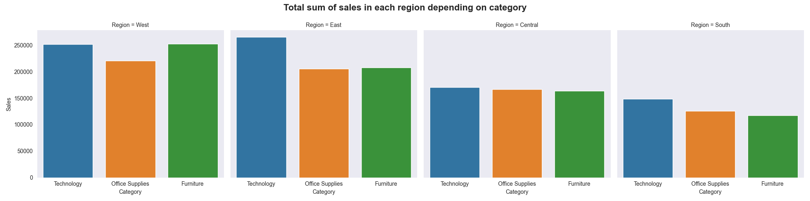
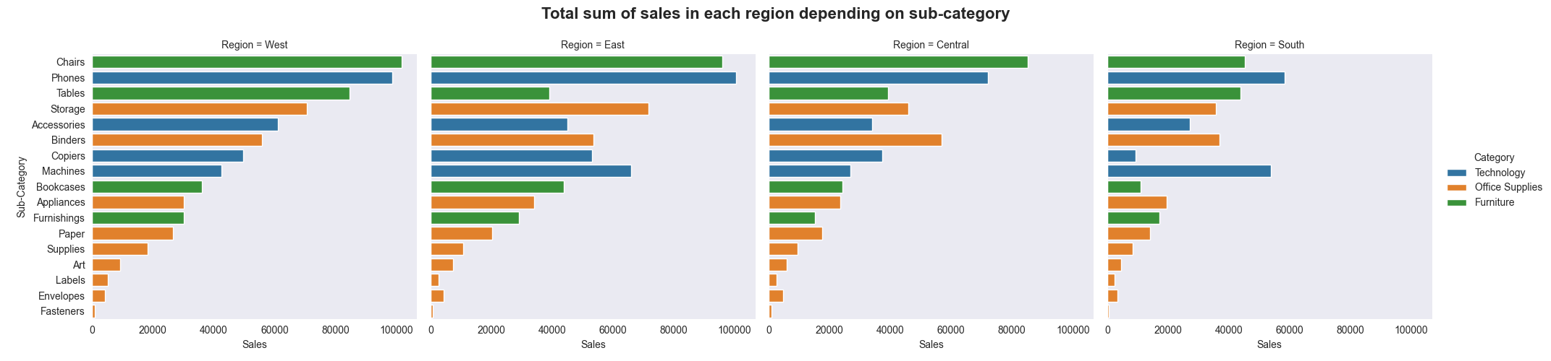

Slide 6
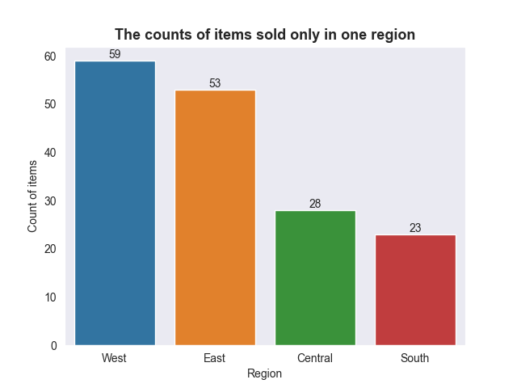
key takeaways
In the southern region, in the subcategory Chairs, the sales volume was much lower compared to other regions
163 (8.7%) items were sold in only one of the four regions
Five items of products were sold only in a single copy

Slide 7
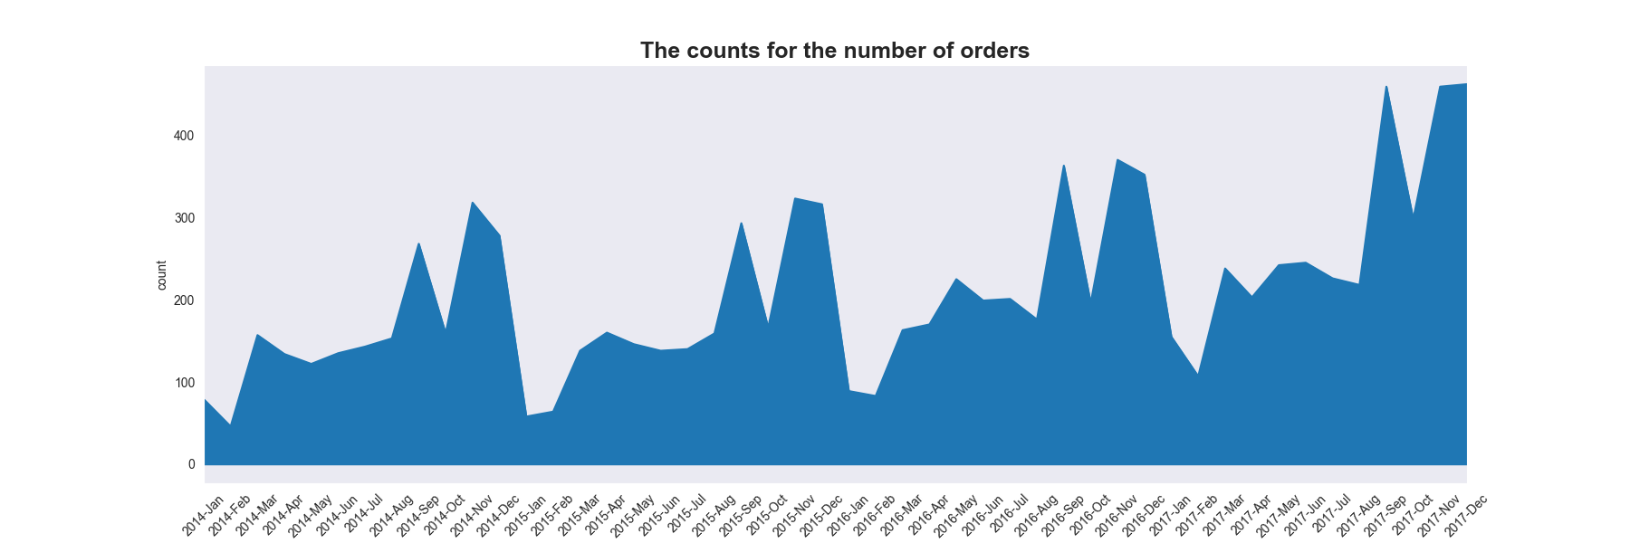
Seasonal general trend in the number of orders
key takeaways
Decrease in the number of orders in February
Increase in the number of orders in September and November

Slide 8
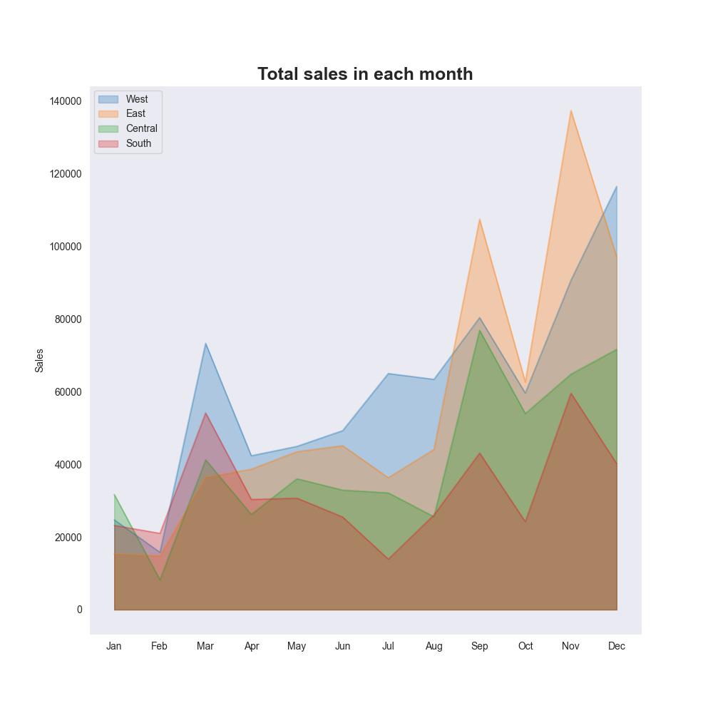
key takeaways
Seasonal general trend of total sales for all regions
Decrease in sales in February
Increase sales in September, November and March

Slide 9
recommendations to the business for future work
There is potential for sales in the subcategory Chairs in the South region
Reduce the stock of items that are not sold in some regions
Reduce the stock of items that are not sold in some regions
Sales strategies and storage volumes may be adjusted to seasonal demand

